Slide 1
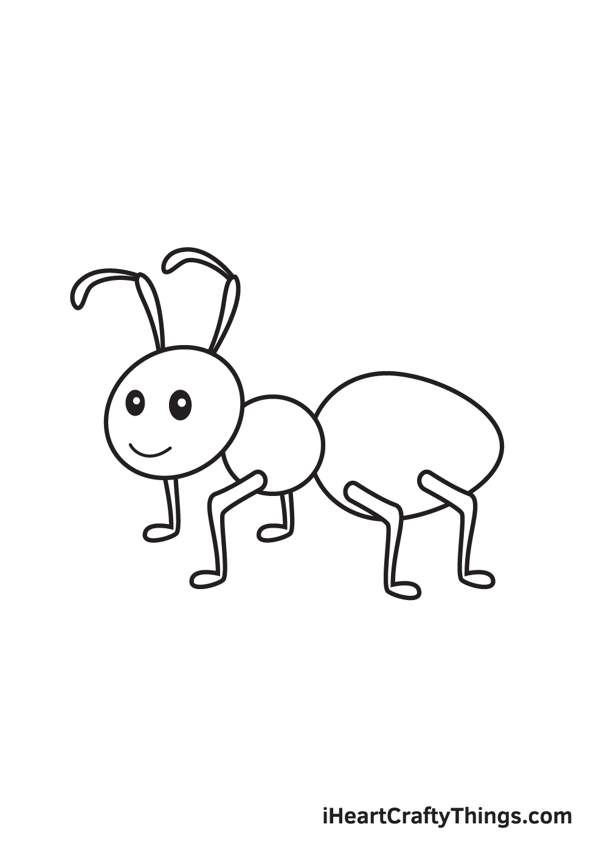
Carpenter Ants
Accessible Design for Different Abilities
Focused on Learning Disabilities

Slide 2
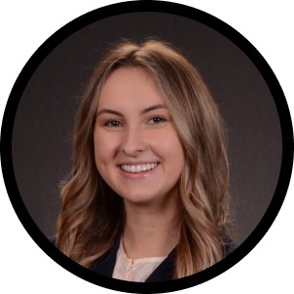

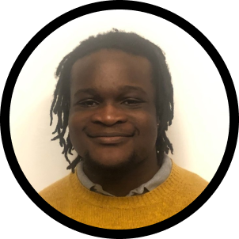

Our Team
Kathryn R.
John W.
JR E.
Ryan A.
English - CS Coterm
Product Design
Computer Science - AI
Computer Science - HCI
Chicago,
IL
San Francisco,
CA
Matthews,
NC
Ormond Beach,
Fl

Slide 3
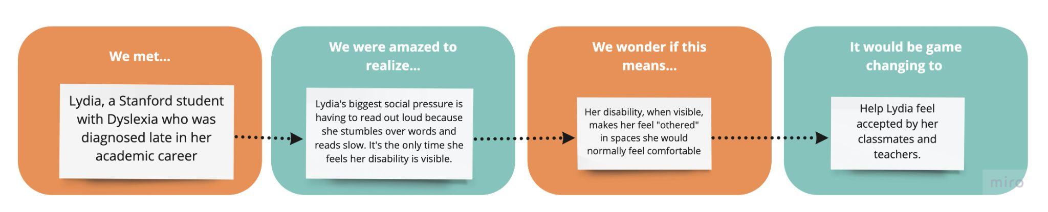
Initial POV

Slide 4


Interviewees
Sylvia
Warren
23 years old
Medical Student
Spinal Cord Injury - Paralysis
25 year old
Early Professional
Obsessive Compulsive Disorder

Slide 5
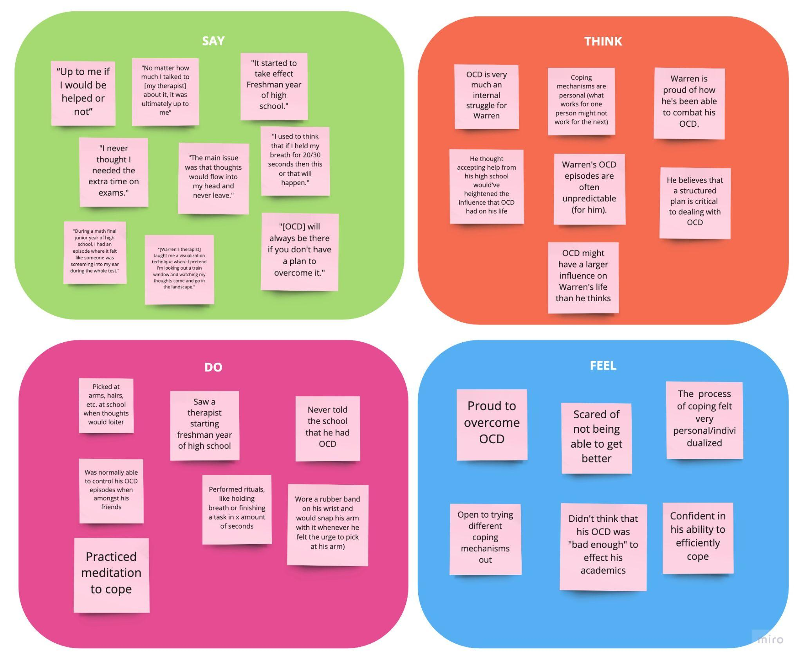
Warren
25 years old
Early Professional
Obsessive Compulsive Disorder
Notes:
Interviewees added a common theme of safety and security, and the support that need for these individuals, without them feeling like they are burdening their communities

Slide 6

- The process of coping with OCD was an internal struggle for Warren, requiring the frequent use of a visualization technique to calm down.
- The effectiveness of certain techniques varies from person to person, working for some and not for others
Warren
25 years old
Early Professional
Obsessive Compulsive Disorder
Notes:
Interviewees added a common theme of safety and security, and the support that need for these individuals, without them feeling like they are burdening their communities

Slide 7
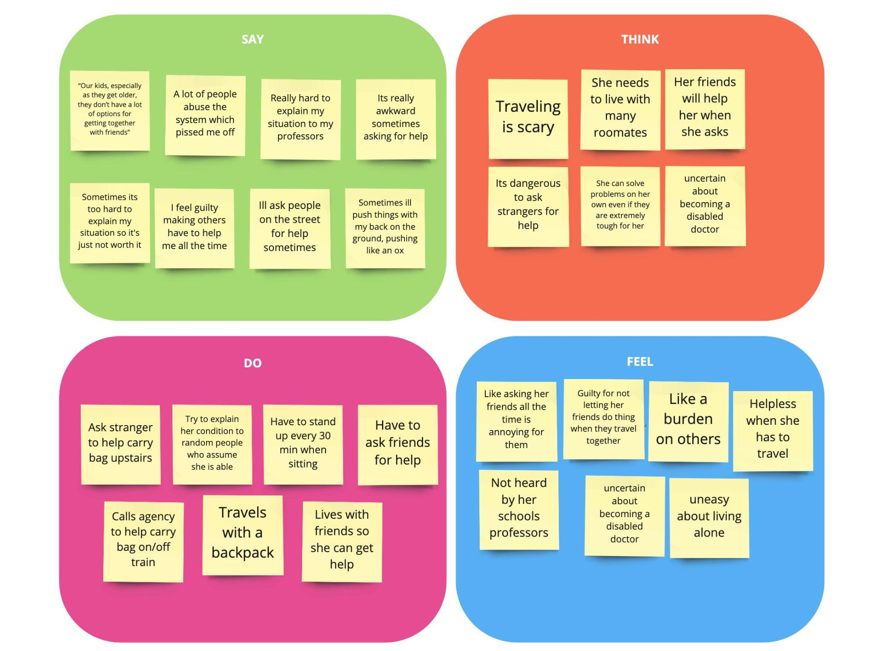
Sylvia
23 years old
Medical Student
Spinal Cord Injury - Paralysis
Notes:
Interviewees added a common theme of safety and security, and the support that need for these individuals, without them feeling like they are burdening their communities

Slide 8
- Asking friends for help is hard for Sylvia because if her roomates are not home she has to text people directly in her area to come help her.
- Reaching out to people directly for help, even if it's over the phone, evokes a sense of guilt.
Sylvia
23 years old
Medical Student
Spinal Cord Injury - Paralysis
Notes:
Interviewees added a common theme of safety and security, and the support that need for these individuals, without them feeling like they are burdening their communities

Slide 9
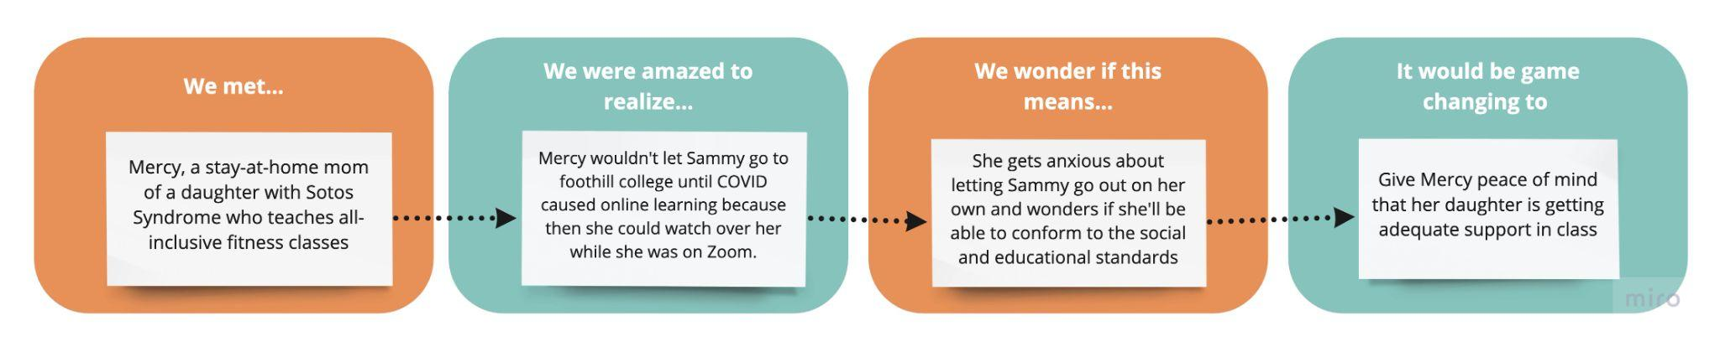
POV 1

Slide 10
How might we provide Mercy with information about her daughter's actions and whereabouts?

Slide 11
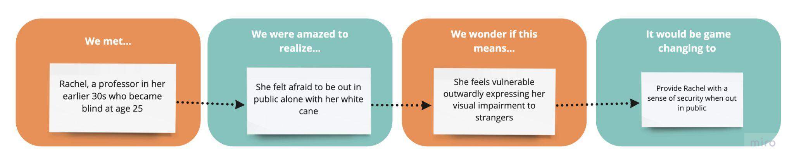
POV 2

Slide 12
How might we match disabled individuals to others who are willing to help?

Slide 13
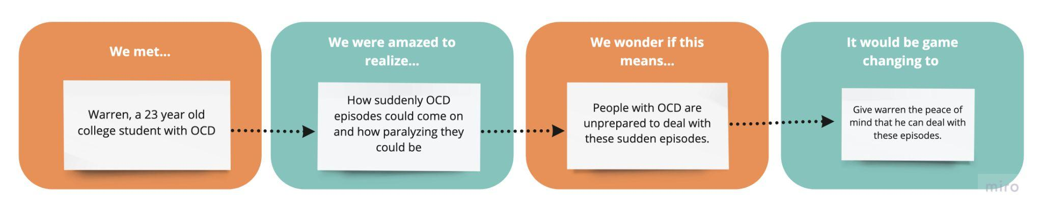
POV 3

Slide 14
How might we make coping mechanisms more accessible?

Slide 15
Solution 1
– How might we match disabled individuals to others who are willing to help?
-Connect those with disabilities to network of friends that could potentially help them in their area with digital help-request platform.
- User can send out help request to friends, people in area get notification and one friend can opt-in to help - Only friends can see how often they have helped/not helped and user does not have to ask for help face to face.

Slide 16
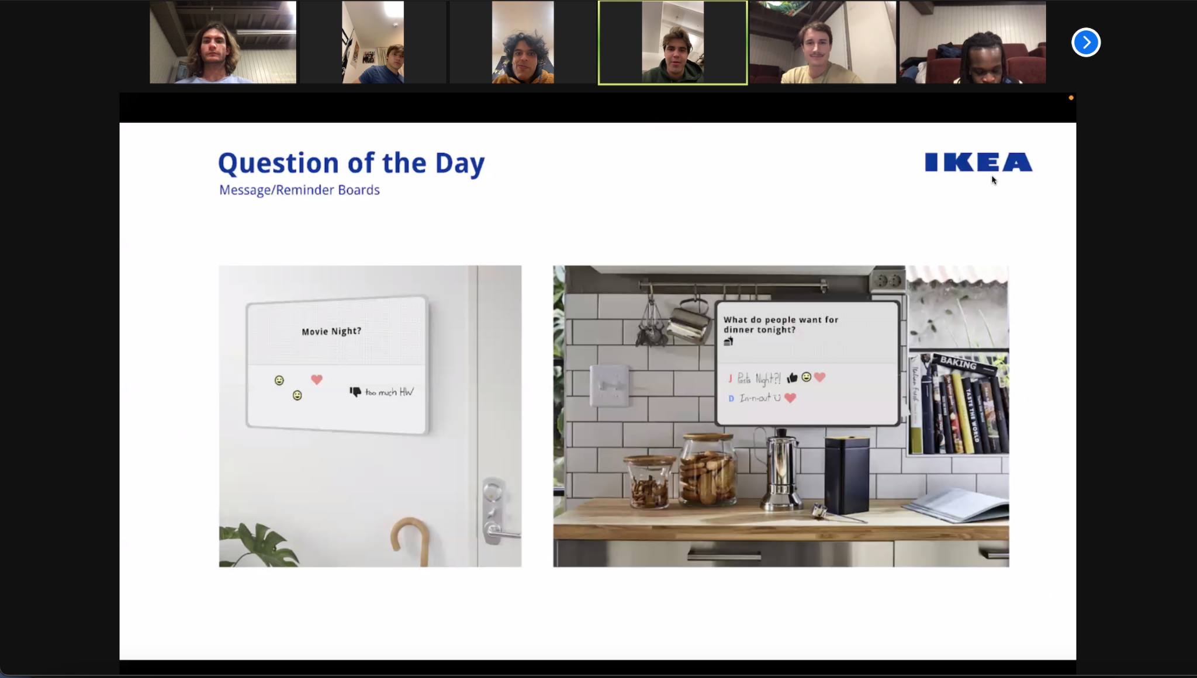
Prototype
Assumption: People feel more comfortable asking for help if the process removed personalized contact and was to a group of respondents.
Prop: Zoom presentation to group
Actors: Stanford students (5-6 per presentation)
How it worked: One presentation where participants were asked to ask questions to just the presenter- second presentation where they knew there were three of us answering questions.

Slide 17
Results
Things that worked:
More people asked questions when they knew there were more people to answer questions
Lots of questions were asked throughout the presentation
Things that didn’t work:
Was hard to get same turnout and give identical presentation - so maybe way it was presented was a factor as well as who was there
Surprises:
The questions posed to the group were, on average, more thought out than those posed to the individual

Slide 18
People feel more comfortable asking for help if the process removes personalized contact and is to a group of respondents.
VALID
Notes:
Assumption was valid, because in our experiment, we found that we got more salient and frequent questions, when the questions were directed to more of an open forum, as opposed to just directing questions during a lecture. This can be compared to the guilt cost one might feel, for example, when posing a question to a lecturer or a TA in class, as opposed to being able to post the question on Ed to crowdsource a response. That being said, we realized that our solution leaves out those not close to their immediate communities.

Slide 19
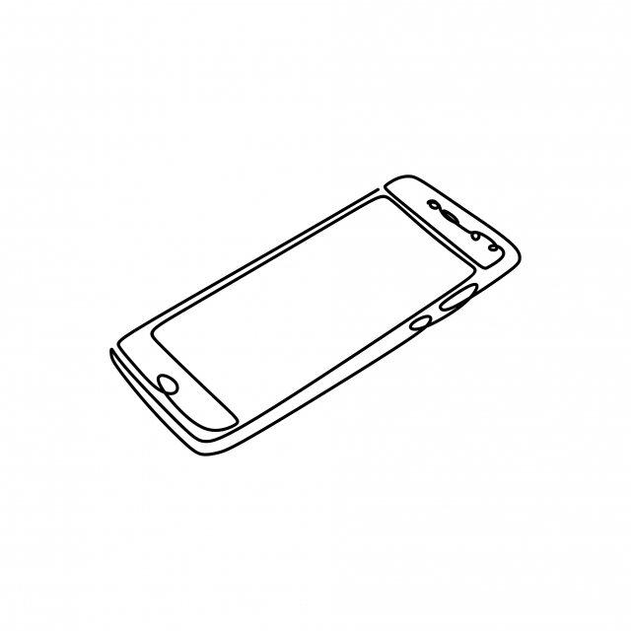
Solution 2
– How might we make coping mechanisms more accessible?
- Create a repository of all OCD coping mechanisms that people who are suffering from episodes can access on their phone.
- Offer individuals the ability to gain access to mechanisms and learn how to cope with their episodes.
- Also offer guided walkthrough of the selected coping mechanisms.

Slide 20
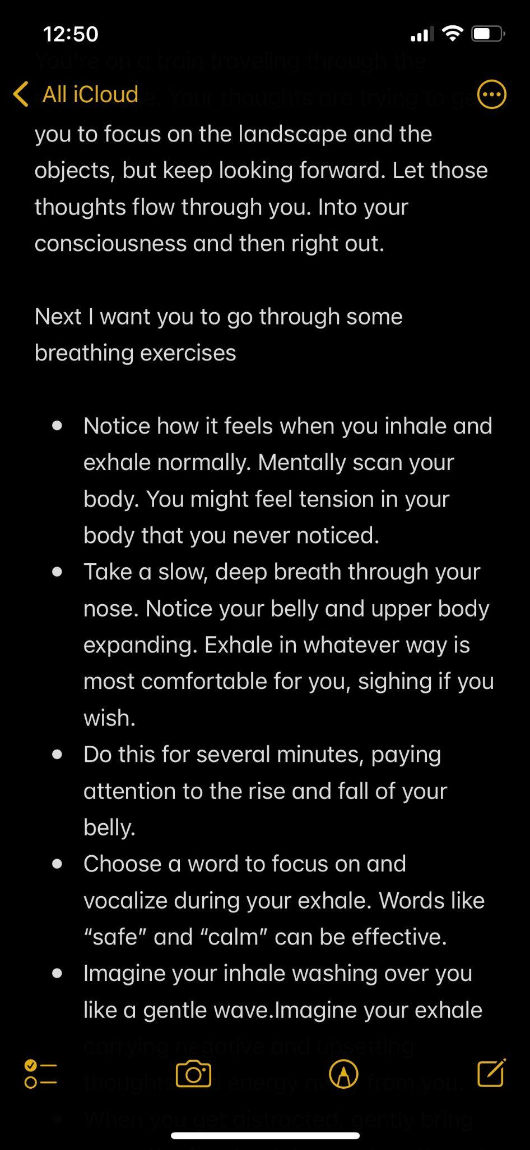
Prototype
Assumption: A phone is an effective medium for leading someone experiencing an OCD episode through various coping mechanisms.
Prototype Description: Provide descriptions of multiple coping mechanisms to someone who suffers from OCD and have them go through one/some of them during their next episode.
How we tested: We texted David, a student with OCD, descriptions of two different coping mechanisms (a visualization activity and a breathing exercise) and told him to read through them the next time that he had an episode. We followed up with David 3 days later and asked him how often he used the exercises and how effective they were for him.

Slide 21
Results
Things that worked:
- Mechanisms were easily accessible
-Anxiety from episode was lowered: “I immediately felt like I had a plan and was confident in fighting back”
Things that didn’t work:
- Visualization tasks were not as easy (some of the mechanisms that required coming up with thoughts in head)
Surprises:
- Breathing exercises were very successful

Slide 22
A phone is an effective medium for leading someone experiencing an OCD episode through various coping mechanisms.
VALID
BUT…
Some coping methods were not as easy when being read as formative tasks (visualization tasks)

Slide 23
Solution 3
– How might we make coping mechanisms more accessible?
- Allow those with mood affecting disorders to quickly track daily emotions.
- On days where users might encounter a trigger, Provide functionality to document coping mechanisms to deal with these triggers, and optionally journal reactions and responses to these coping mechanisms.

Slide 24
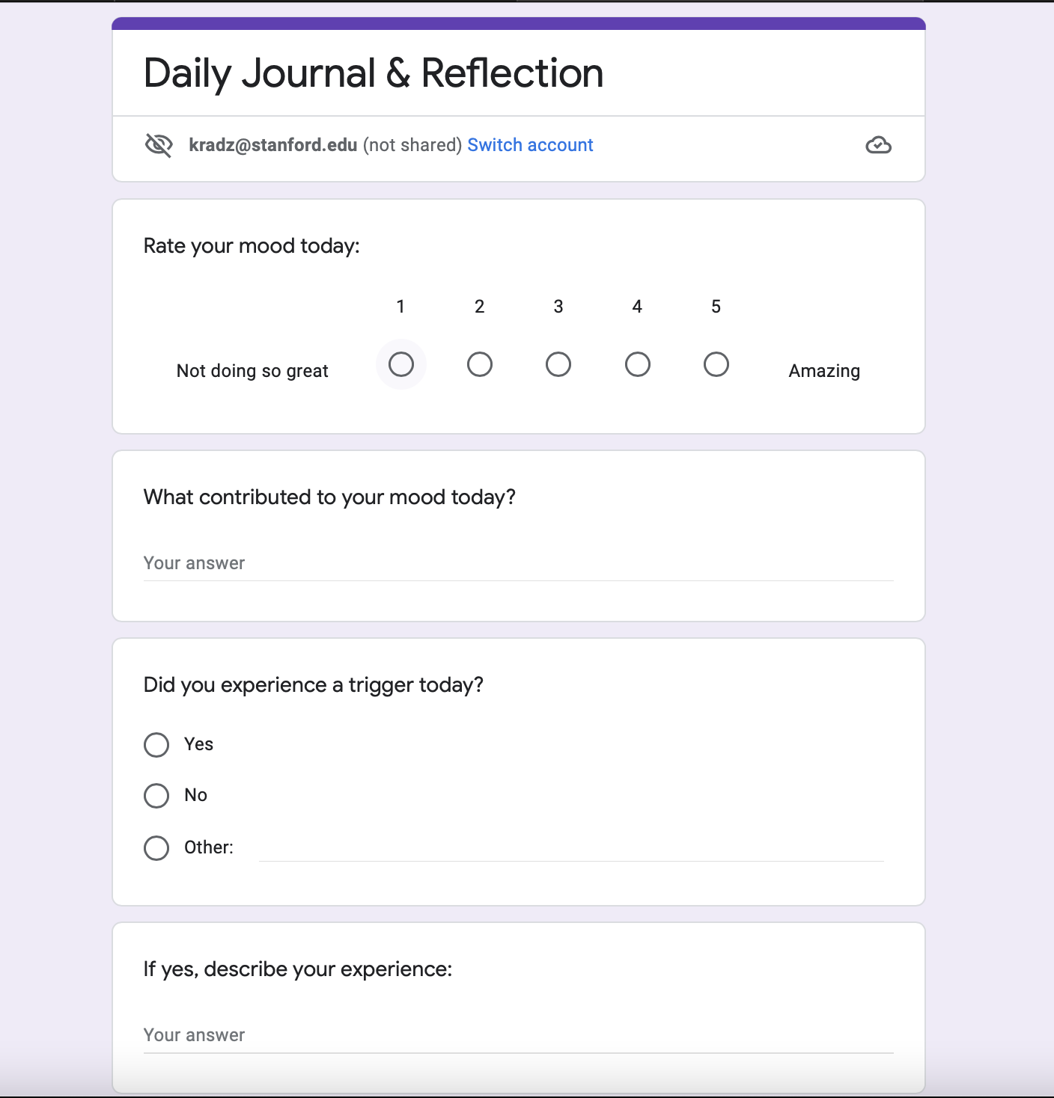
Prototype
Assumption: People are comfortable and willing to confront their triggers head on in order to reflect and grow
Prop: Google form “Journal”
Actor: College student diagnosed with depression
Role: Fill out the form for two consecutive days

Slide 25
Results
Trigger: Unexpected car crash in a movie caused a panic attack
Past Occurrences: 10-15
Things that worked:
Improved their mood
Generally positive and helped them move past it
Things that didn’t work:
“Sometimes it made me feel worse”
Hard to revisit
Surprises:
Helpfulness depended on the day/severity of the trigger
Notes:
Participant filled out the form two days in a row
One day they experienced no triggers, the next they had one
Trigger was one that recurs frequently in their lives

Slide 26
People are comfortable and willing to confront their triggers head on in order to reflect and grow
VALID
BUT…
A daily mood journal would be more productive than one that could be used as the user
Notes:
-Valid because even though the triggers were difficult to revisit, the participant said it was generally a positive experience and felt like it helped them move on from the trigger
-led to another assumption - a daily journal would be more useful than a sporadically used journal

Slide 27
We learned…
Confronting emotional triggers can be beneficial, but there may be a limit as to how frequent one is comfortable with the action
OCD episodes can effectively be dealt with through self-lead walk throughs of coping mechanisms, but formatting these personalized list has an effect on the user’s experience.
People are more comfortable asking questions to a group vs an individual, and questions posed to groups are typically more elaborate than those posed to individuals.

Slide 28
What’s next…
Solution 1: Connect those with disabilities to network of friends that could potentially help them in their area with a digital help-request platform.
The needs this solution addresses were recognized in the most diverse range of individuals with both physical and mental disabilities
Next we hope to test some more of this solution’s assumptions with new prototypes.

Slide 29
Thank you!
Any Questions?

Slide 30
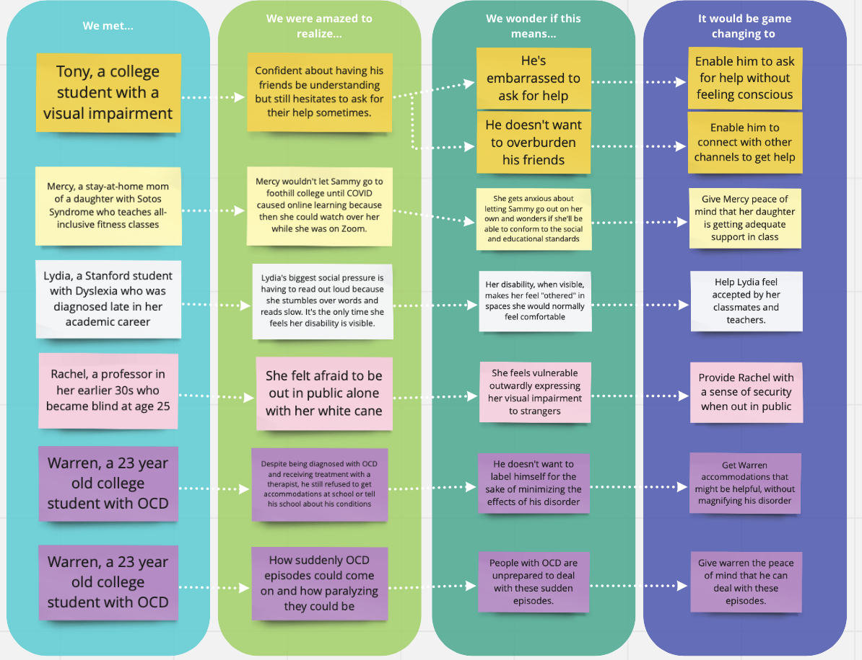
Appendix: POVs

Slide 31
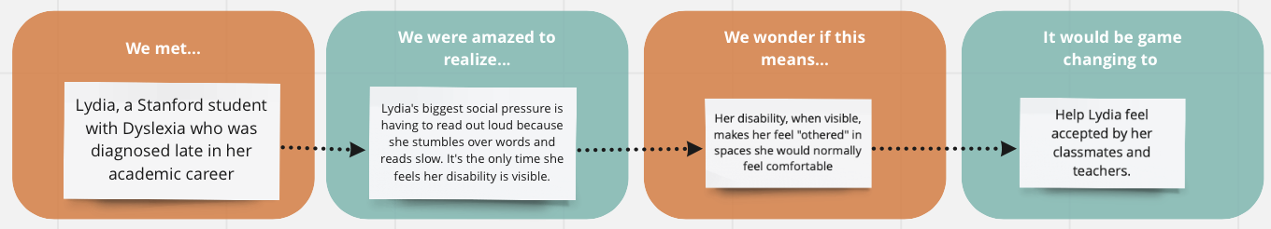
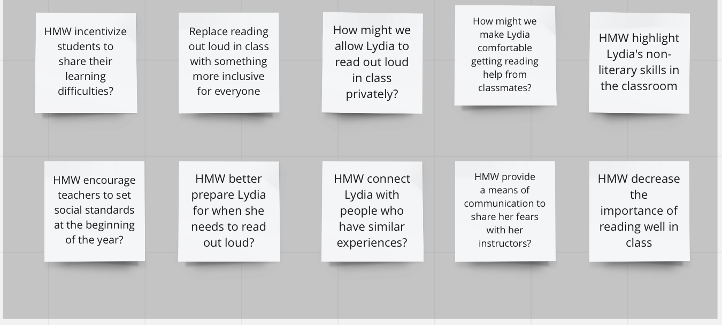
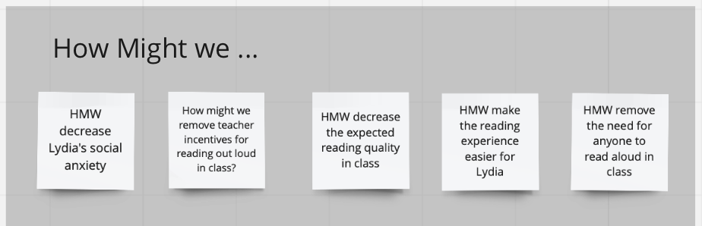
Appendix: HMWs for each POV

Slide 32
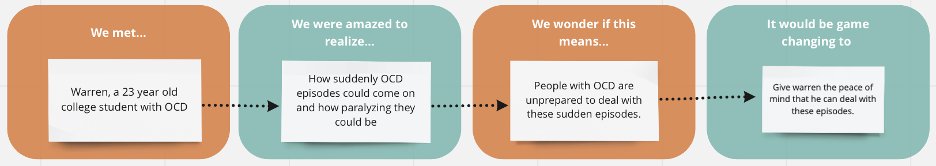
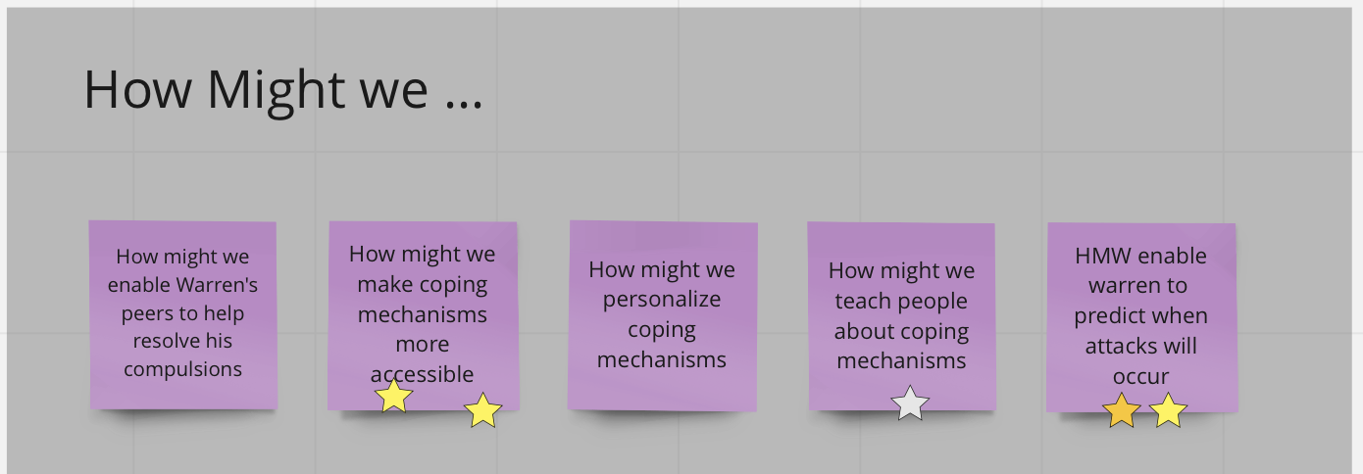
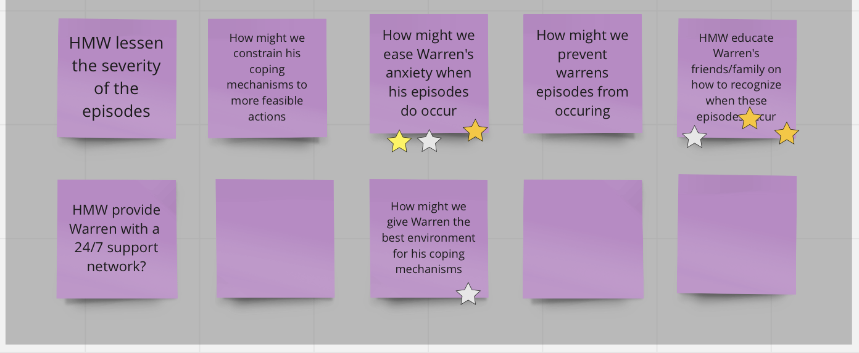
Appendix: HMWs for each POV

Slide 33
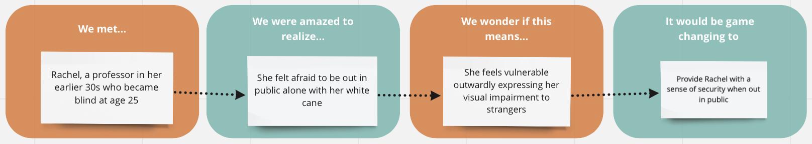
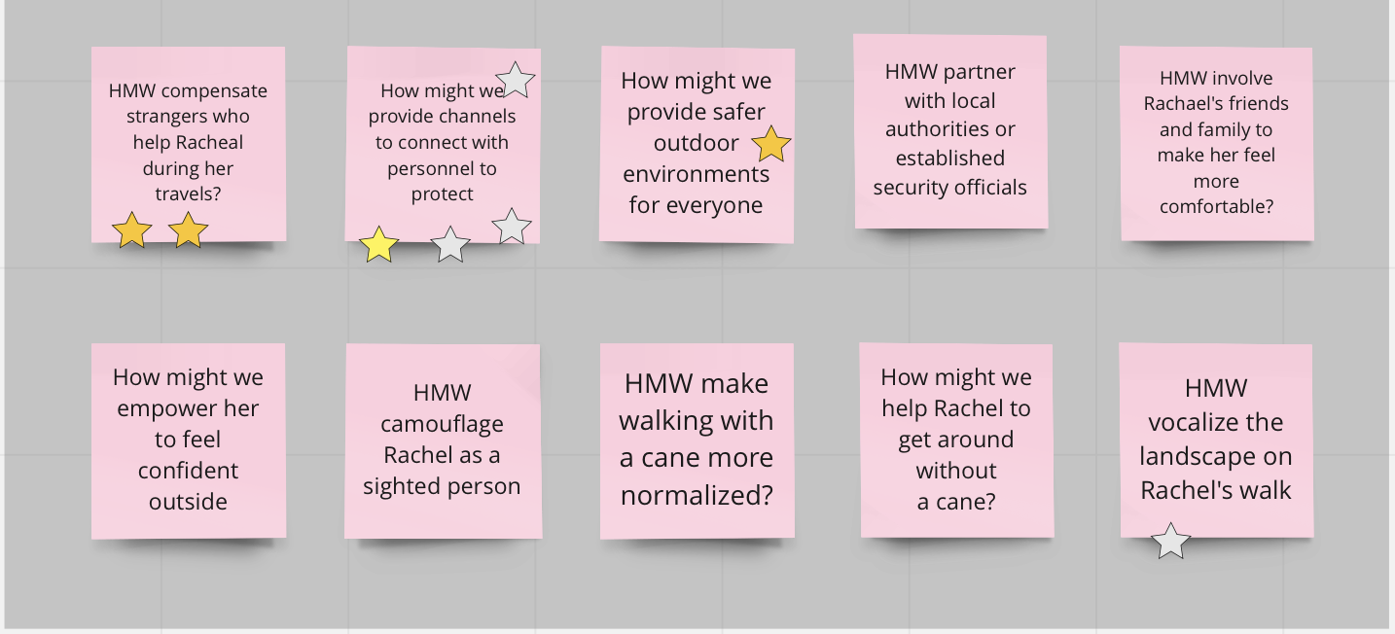
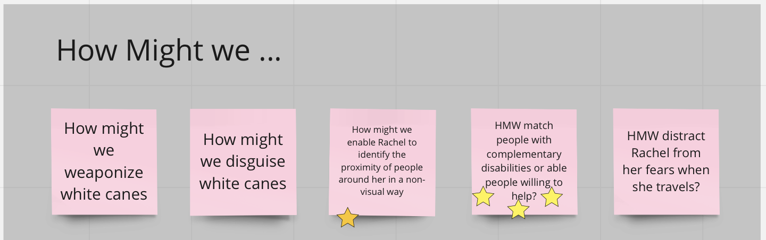
Appendix: HMWs for each POV

Slide 34
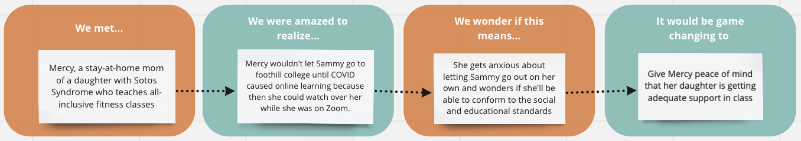
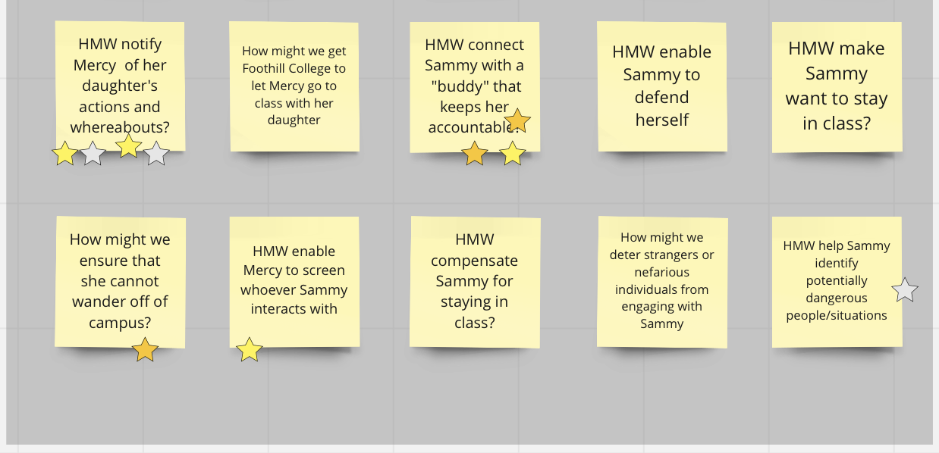
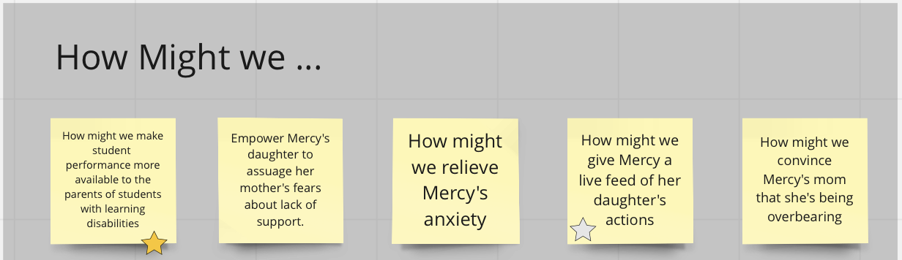
Appendix: HMWs for each POV

Slide 35
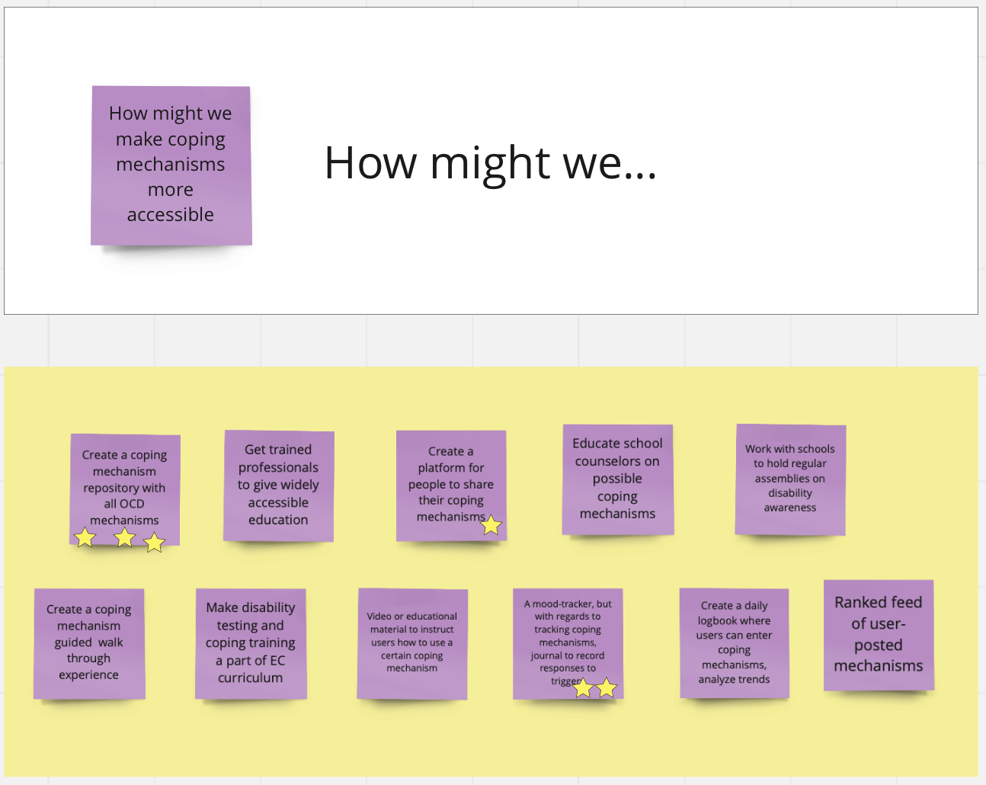
Appendix: Solutions for each HMW

Slide 36
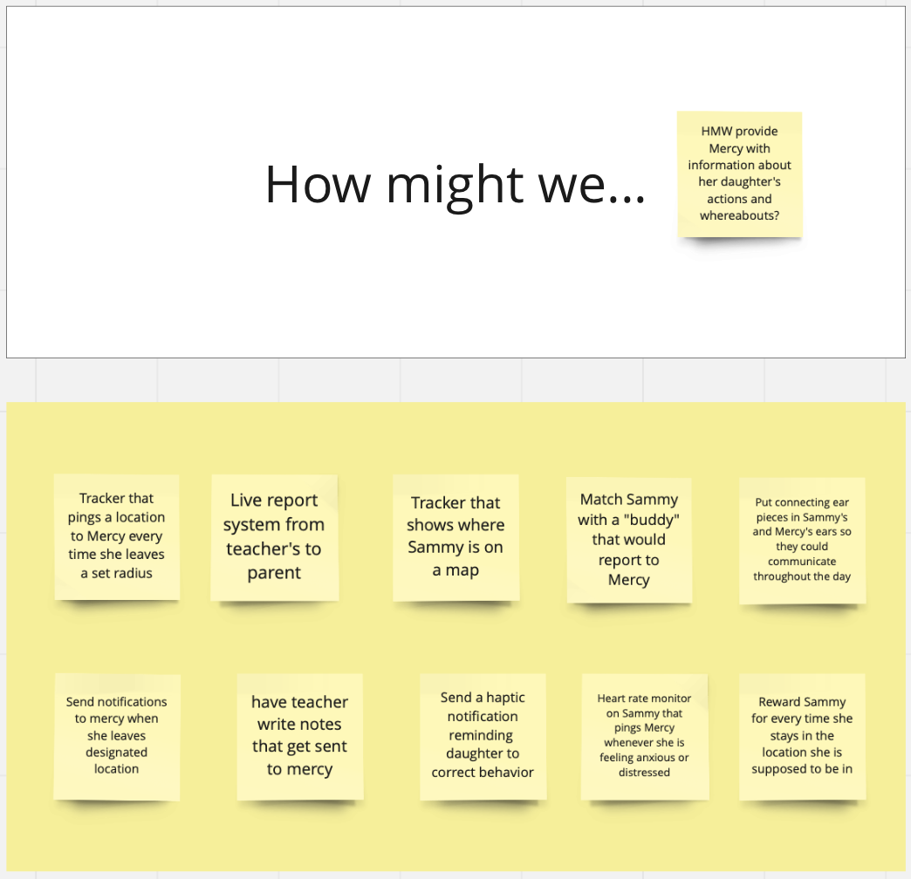
Appendix: Solutions for each HMW

Slide 37
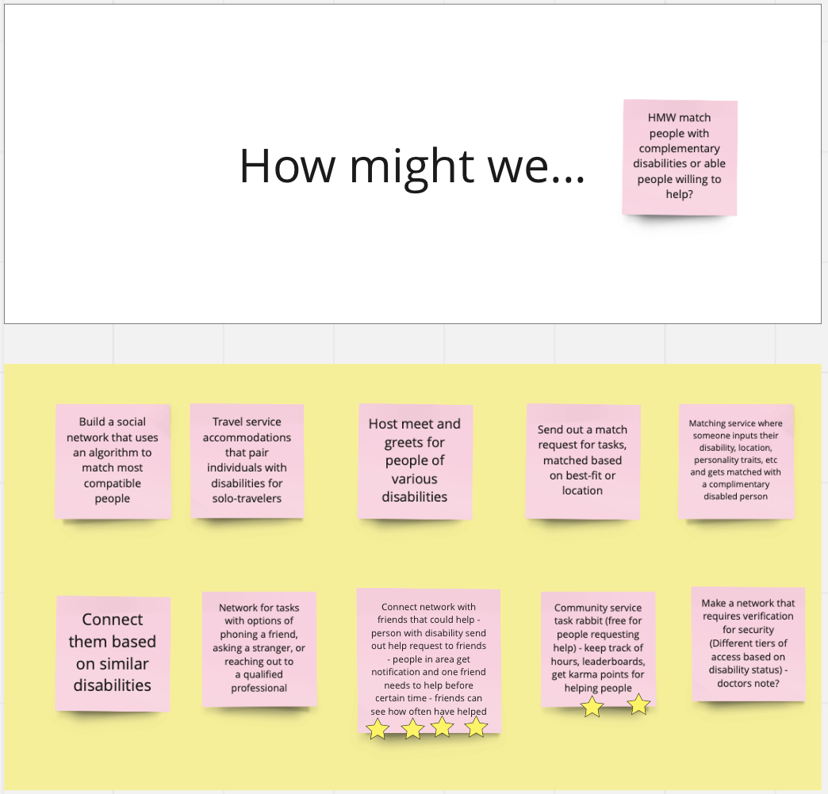
Appendix: Solutions for each HMW

Slide 38
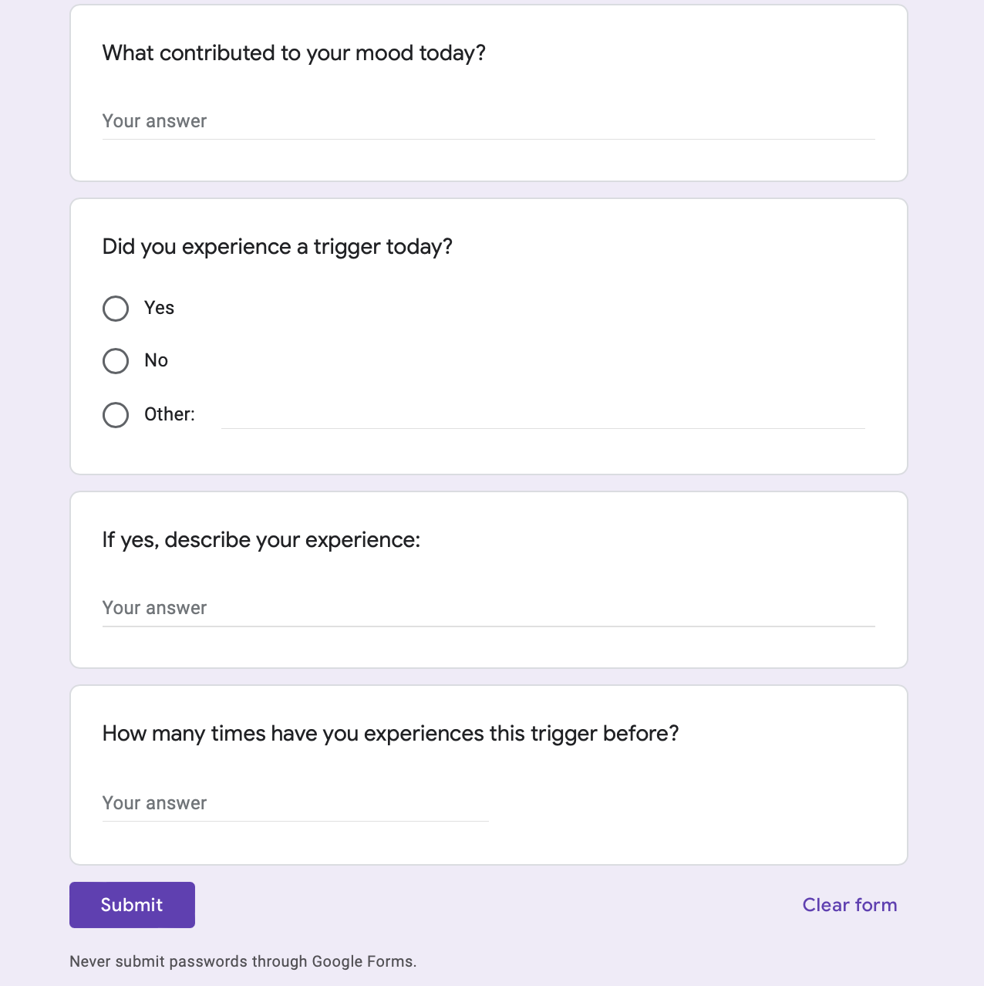
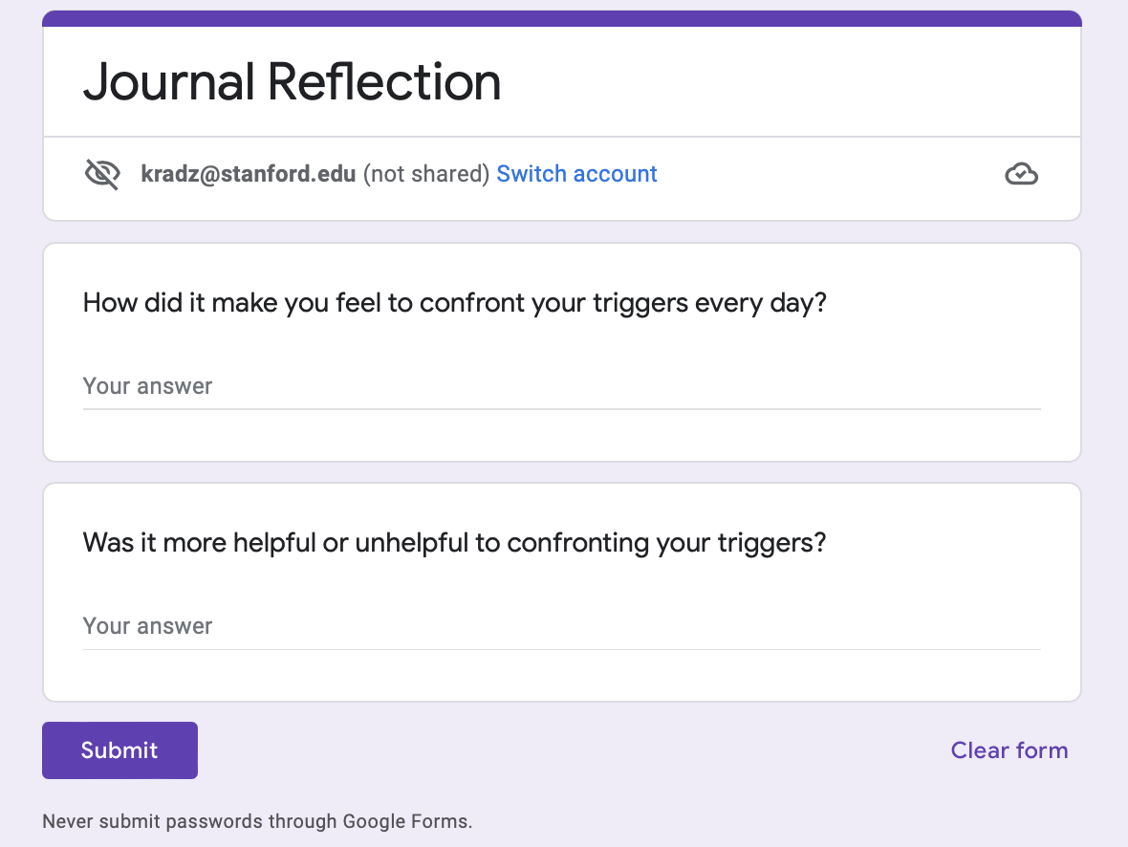
Appendix: Google Form Prototype Questions

